Slide 1
Computer Programming
Shakir Ullah Shah,
National University of Computer & Emerging Sciences
FAST-NUCES

Slide 2
Outline
Programming Languages
Language Translators

Slide 3
Programming Languages
To communicate between human beings and computers
Instruct a computer (H/W) to do what you want to do
Each computer can understand its own machine language only
Instructions are written in programming languages and then translated into the corresponding machine language.

Slide 4
Machine Language
First generation language
Consists of 1 and 0
Only language that computers can understand
Each computer has its own machine langue (machine dependent)
No translation
Difficult to write and read programs

Slide 5
Assembly Language
Second generation language
Replace machine language’s binary codes for instructions and addresses with corresponding symbols and mnemonics
1:1 match
Translated by the assembler
More technical and faster
But less flexible and user friendly

Slide 6
High Level Languages 1
Less machine dependent
More readable and flexible (closer to human languages and farther away from machine language)
But less efficient (bigger and slower)
Need to be translated into a machine language (interpretation or compilation)

Slide 7
High Level Languages 2
BASIC (Beginner’s All-purpose Symbolic Instruction Code)
FORTRAN (FORmula TRANslator) by IBM
COBOL (Common Business Oriented Language) by ANSI.
PL/1
Pascal
ADA

Slide 8
High Level Languages 3
C by Bell Lab
C++, and Visual C
JAVA by Sun Microsystems
Web programming (script) languages: Perl, PHP, Python, Ruby

Slide 9
Types of Languages 1
First generation (machine language)
Second generation (assembly language)
Third generation (high level language)
Forth generation (query languages)
Fifth generation (natural & intelligent languages)

Slide 10
Type of Languages 2
Low-level languages (i.e., machine & assembly language)
High-level languages (e.g., C and Java)
Script languages (e.g., Perl, PHP, Python)

Slide 11
Programming Paradigms
Procedural programming
Object-oriented programming
Functional programming
Declarative programming

Slide 12
Procedural Programming 1
Imperative or structured languages
Tells the computer what you want it to do step by step
FORTRAN, COBOL, BASIC, C, Pascal, Ada

Slide 13
Procedural Programming 2
Procedures (actions) & objects (data) are independent
Passive objects that cannot initiate an action by itself
A subprogram (routine or module) is a section of the program that performs a particular task when it is called from the main program.

Slide 14
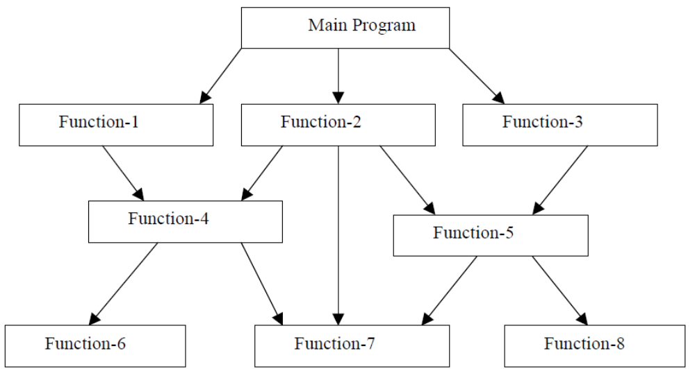
Typical structure of procedural oriented programs
Notes:
Typical structure of procedural oriented programs

Slide 15
Object-oriented Programming 1
Active Objects have both data and methods (procedures or actions)
Methods are not independent of but belong to the active object.
Objects need stimulus to perform actions
Visual Basic, Visual C, C++, Java, Smalltalk
Even in script languages (PHP & Python)

Slide 16
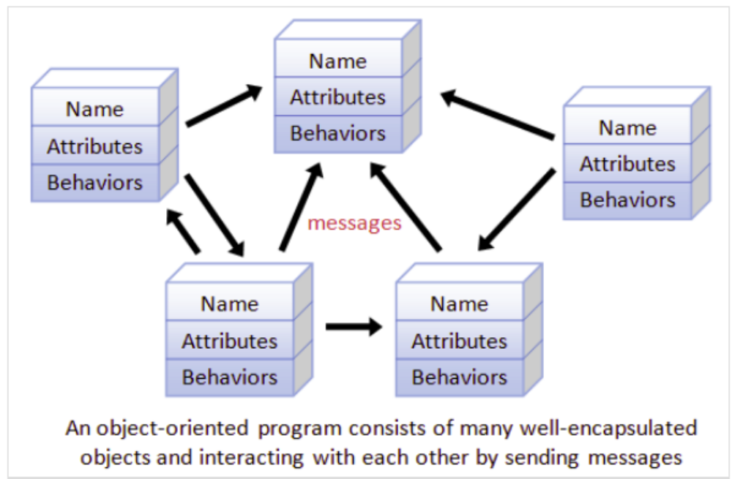
Object-oriented Programming 2

Slide 17
Object-oriented Programming 3
A class is a abstract blueprint of objects that have data and methods
An object (instance) is an (actualized) instance of the class (variables + actions)
A class of human beings (name, gender, height… + eating, sleeping, speaking …)
An object of human beings (Seohyun, 170cm, 40Kg … + eating milk, … )

Slide 18
Object-oriented Programming 4
class human {
public name …
public height …
…
function eating (…) {
…
}
function studying (…) {
...
}
…
} // end of class

Slide 19
Object-oriented Programming 5
Inheritance: a class can inherit from other classes. A class student inherits data and methods from a class human being and additionally has its own data and methods
Student = human beings + student’s data and methods
Faculty = human beings + faculty’s data and methods
Codes are reusable (minimize redundancy)

Slide 20
Object-oriented Programming 6
Data abstraction and decoupling: separating objects from classes
Encapsulation and information hiding: Data are bound closely with their methods.
Polymorphism enables to define methods with the same name that do difference things depending on classes.
  A work() may mean teaching in a class faculty but farming in a class farmer.

Slide 21
Language Translators

Slide 22
Language Translators 1
Computer can understand machine languages only
Language translators translate source codes into the machine language.
A source code file needs to be compiled and linked to be an object file, executable file.

Slide 23
Language Translators 2
Lexer reads a source code (program) character by character and assembles characters into reserved words (token)
Parser performs syntactic analysis and converts tokens to nodes on a syntax tree.
Code generator produces segments of machine code of each node.
Optimizer inspects machine codes and eliminates redundancies.

Slide 24
Language Translators 3
Assembler translates a assembly program
Interpreter (interactive)
Compiler (non-interactive, batch)

Slide 25
Interpreter
Interactive way of communicating between users and machines.
Translates each line of the source programs one by one, run it without making an object file, and then return the result promptly.
Java source →Bytecode by Java compiler → interpreted by JVM emulator
BASIC, LISP (LISt Processor) by MIT for artificial intelligence

Slide 26
Compiler
Compiler translates a whole source code into an object code before executing it.
Most high level languages (e.g., C and Java) are translated by their compilers.
Source code → Object file → Linking libraries → Executable file
A library is a collection of commonly used modules that are combined into the executable file.

